Slide 1

Liver Tumor Segmentation in CT scans Using Deep Learning Techniques
Proposal and Feasibility Presentation
Faizan (FA21-BSE-011)
Fawad Iqbal (FA21-BSE-012)
Dr. Mubashir Ahmad
Department of Computer Science
COMSATS University Islamabad, Abbottabad Campus

Slide 2
Agenda of the Presentation
Introduction
Importance of liver cancer diagnosis.
Challenges
Issues with manual diagnosis and the need for automation.
Proposed Solution
Overview of nnFormer architecture.
Research Objectives
Goals of implementing nnFormer for liver tumor segmentation.
System Modules
Key functionalities: Image Upload, Detection, Results Dashboard.
Feasibility
Technical, financial, resource, and operational aspects.
Conclusion
Recap of project goals and impact.

Slide 3
Motivation
Importance of Liver Cancer Diagnosis:
Liver cancer is a leading cause of death worldwide, causing over 800,000 deaths.
It's a serious public health threat, highlighting the urgent need for accurate liver cancer diagnosis.
CT (Computed Tomography) images are critical for detecting liver tumors, which assists in effective treatment.

Slide 4
Cont.…
Challenges in Manual Diagnosis
Manual liver tumor diagnosis is:
  Time-consuming
  Dependent on physician expertise
  Difficult due to unclear liver edges in images
This raises the demand for automating the segmentation of liver tumors.

Slide 5
Cont.…
Automation Challenges and Proposed Solution
Automation challenges:
Liver shape is affected by neighbouring organs.
Blurred boundaries with organs like the spleen and stomach.
Lesions can distort liver shape and appearance.
Proposed Solution: The nnFormer architecture:
Integrates convolutional layers and attention mechanisms.
Captures both local and global context for accurate segmentation.
Processes images as smaller patches to reduce computational complexity.

Slide 6
Introduction to Liver Tumor Segmentation
Liver Cancer: A Global Concern
Leading cause of cancer-related deaths: 800,000+ deaths annually.
Importance of Accurate Diagnosis
Critical for effective treatment.
Relies on interpreting CT images to identify tumors.
Challenges in Manual Diagnosis
Time-consuming and requires significant expertise.
Difficulty in identifying liver boundaries due to neighbouring organs.
Need for Automation
Demand for automated segmentation processes.
Proposed Solution: nnFormer Architecture
Integrates convolutional layers with self-attention mechanisms.
Aims to improve segmentation accuracy and reduce computational complexity.

Slide 7
Scope
What to Do:
Our research focuses on implementing the nnFormer architecture for the automated segmentation of liver tumors in CT scans. We aim to accurately segment liver structures, enhancing diagnostic precision while reducing the time needed for analysis. By utilizing the Lits17 database for training and testing, we will compare the performance of nnFormer against existing models such as CNN-based UNet, TransUNet, and SwinUNet, demonstrating its effectiveness in improving segmentation accuracy and efficiency.
What Not to Do:
We will not rely solely on manual segmentation methods, which are often time-consuming and prone to human error. Full 3D images will not be used due to resource constraints; instead, we will process 2D images to facilitate analysis. Our approach avoids overly complex models that could increase computational demands, and we will not overlook the challenges posed by neighboring organs and blurred boundaries in imaging, which are critical for achieving reliable segmentation results.

Slide 8
Functionalities
1. Image Upload
  Let's users upload a 2D CT scan image for analysis.
2. Liver and Tumor Detection
  Uses a model to highlight and separate the liver and tumor areas in the scan.
  Shows the original image alongside the segmented (processed) image.
3. Results Dashboard
  Displays the processed images side-by-side for easy comparison.
  Includes key metrics like tumor size and location.
4. Quick Analysis Tools
  Visual chart showing the ratio of tumor area vs. healthy tissue.
  Easy-to-use interface, designed for a clear view of results to assist in diagnosis.
5. Efficient and Adaptable
  Built to handle images on regular computers without needing high-end hardware.
  Flexible enough to support future upgrades, like adding new ways to improve segmentation.

Slide 9
Proposed Tools/Platform
Tools & Technologies | Version | Role
Python | 3.12.4 | Main programming language for developing the system.
PyTorch | 2.5.1 | Deep learning framework for implementing the nnFormer model.
Rstudio | 2024.09.0+375 | User for data analysis and visualization, assisting in data preprocessing.
Matplotlib | Latest | Library for visualizing results and generating plots.
NumPy | Latest | For data manipulation and preprocessing before model input.

Slide 10
Proposed Tools/Platform Cont…
Tools & Technologies | Version | Role
PyCharm | Community 2023.3 | IDE for efficient code development and debugging.
MS PowePoint, Miro | 2015 | For creating and presenting project reports and slides.
Flask | 2.1.3 | Framework for building the web application backend.
Lits17 Dataset | 2017 | Medical imaging dataset for liver tumor segmentation training.
Github | Latest | Version Control
MITK Workbench | 2024.06.02 | For manually diagnosing the Liver and Tumor

Slide 11
Feasibility
Technical feasibility
1. Compatible Technologies
Python and PyTorch: for implementing and training nnFormer.
Flask: Providing an interactive web interface.
2. Effective Models and Libraries
nnFormer architecture for precise liver and tumor segmentation.
NumPy, Matplotlib: Data handling and result visualization.
3. Dataset Optimization
Lits17 Dataset: High quality liver CT scans.
Extracting 2D images from 3D volumes as an input to the model.

Slide 12
Feasibility Cont.…
Financial feasibility
1. Training Model Cost:
Free resources from Google Colab and Kaggle can help reduce the need for personal high-end hardware, saving $1000 – $2000 upfront GPU costs.
Savings on data storage by using Google Drive integration with colab.
2. Software Costs:
PyTorch: Open-source, no cost.
Flask: Open-source, no cost.
IDE (PyCharm Community): Free version sufficient for development needs.
Anaconda: Open-source, package management at no cost.

Slide 13
Feasibility Cont.…
Resource feasibility
Cloud-Based GPU/TPU Resources:
Google Colab:
  Access to free and affordable GPU/TPU resources that are suitable for model training and testing.
  Colab Pro ($9.99/month): Extended sessions up to 24 hours with access to high end GPUs (e.g., V100).
  Colab Pro+ ($49.99/month): Up to 32 GB of RAM and the latest GPUs.
Kaggle:
  Free access to NVIDIA GPUs for limited hours per week.
  Suitable for regular, shorter training sessions without additional cost.

Slide 14
Feasibility Cont.…
Resource feasibility Cont.…
2. Medical Imaging Dataset:
Lits17 Dataset: A reliable and relevant dataset for liver tumor segmentation in CT scans.
Ensures we have enough data available for training and validating the nnFormer model.
3. Human Resources:
Team Members: Students with a background in software engineering, familiar with python, deep learning, frameworks, and software development.
Supervisor: Guidance on medical imaging techniques and segmentation metrics if required.

Slide 15
Feasibility Cont.…
Operational feasibility
User-Friendly Interface:
Simple web dashboard for CT scan uploads, segmentation results, and analytics, designed for easy use by medical staff.
2. Resource Integration:
Leverages Google Colab and Kaggle for GPU needs during training, deployable on general-purpose systems for everyday use.
3. Modular & Scalable:
Easily maintainable with PyTorch, and Flask.
Will be ready for updates, new models, and additional functionalities.

Slide 16
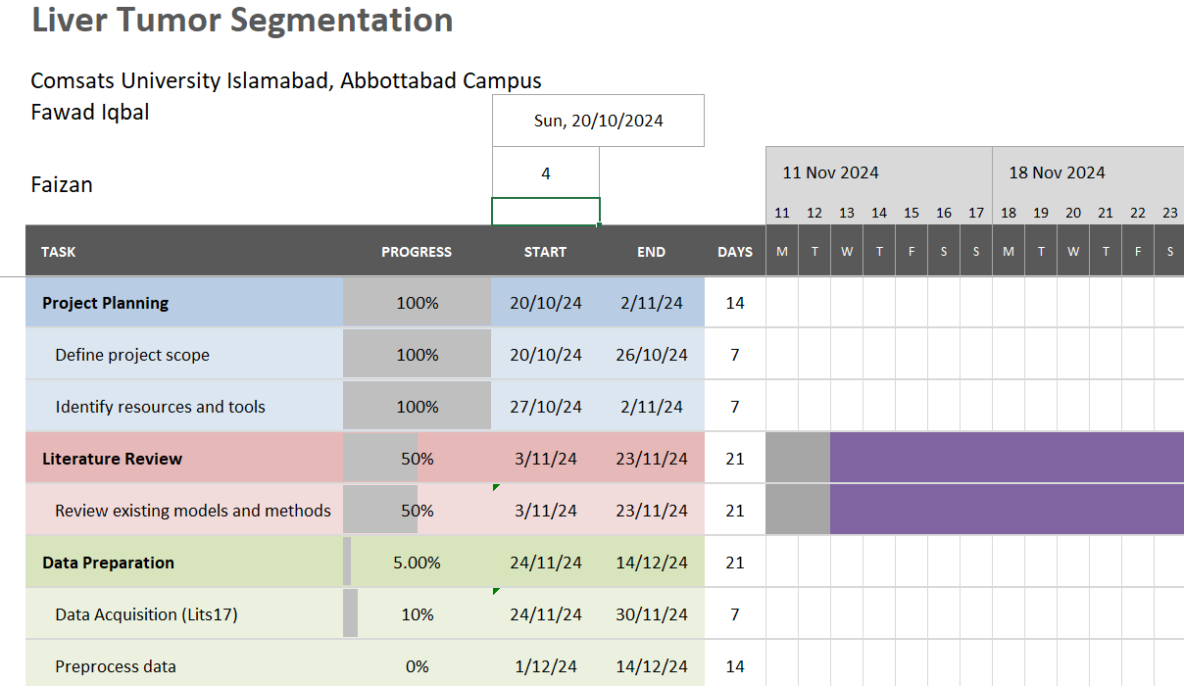
Schedule

Slide 17
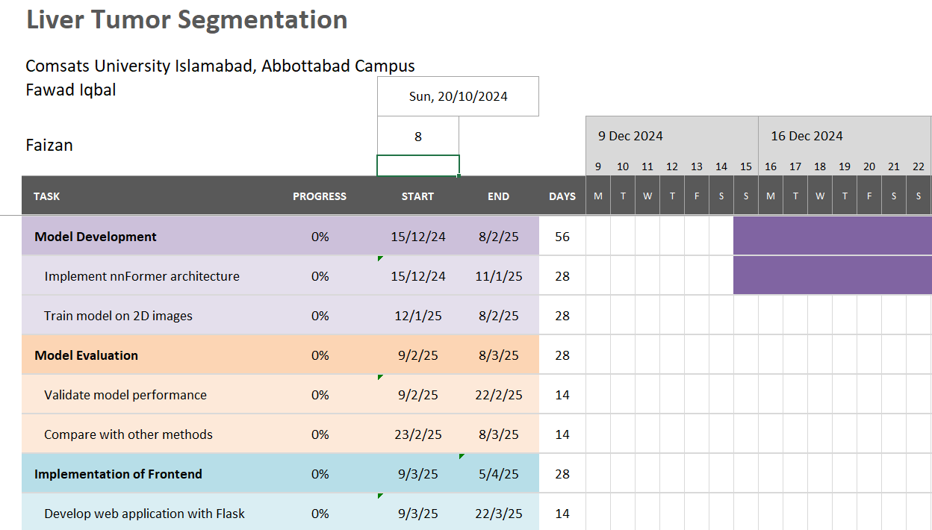
Schedule Cont.…

Slide 18
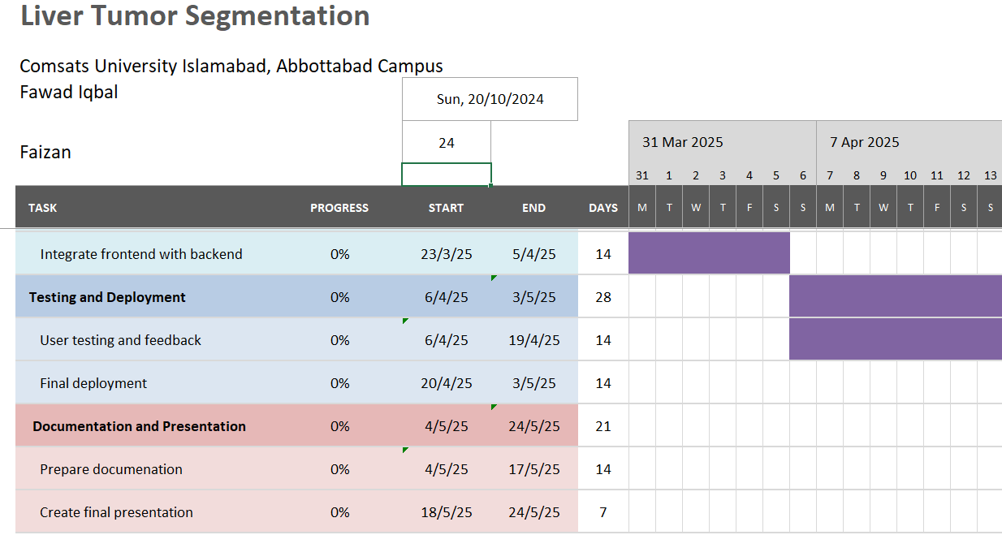
Schedule Cont.…

Slide 19
Tasks for 1st Iteration (or 30%)

Slide 20
Conclusion
In conclusion, our research is based on advanced deep learning techniques, specifically the nnFormer architecture, to enhance the accuracy and efficiency of liver tumor segmentation in 2D CT scans.
Our system aims to assist medical professionals to diagnose the liver tumors with better precision and less time, providing an accessible and user-friendly interface.

